Slide 1
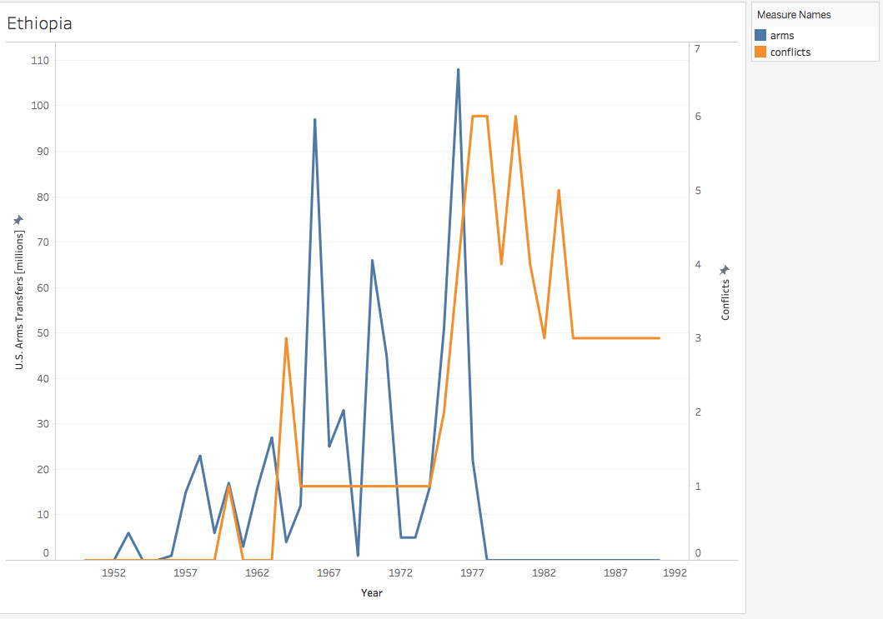
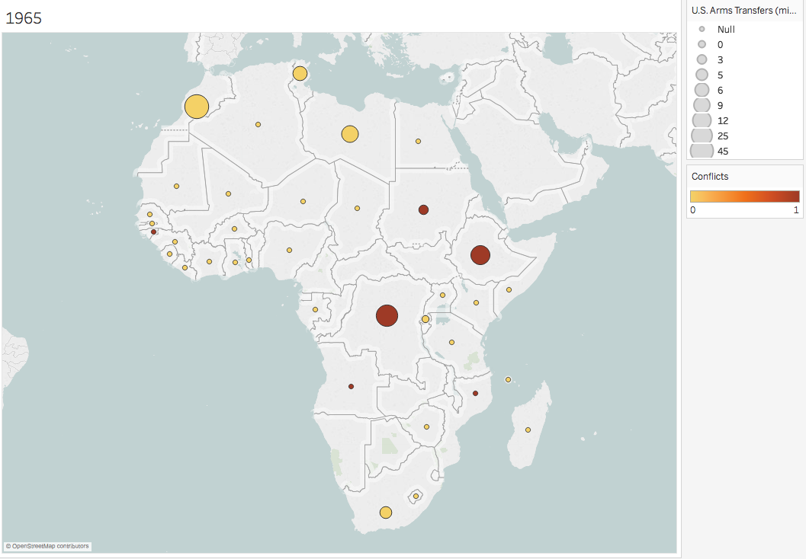
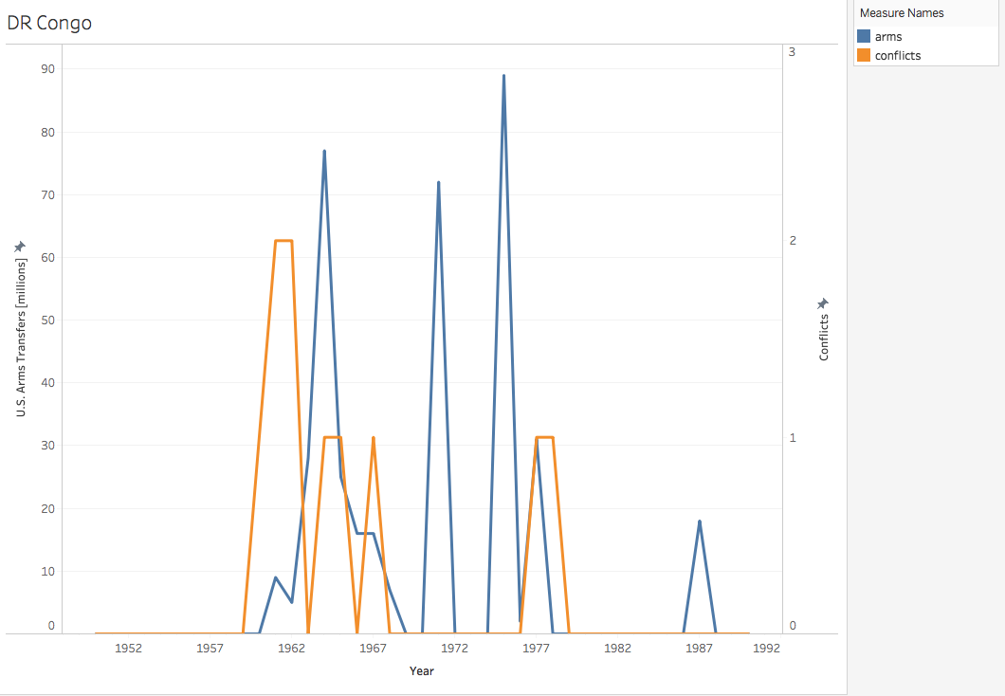
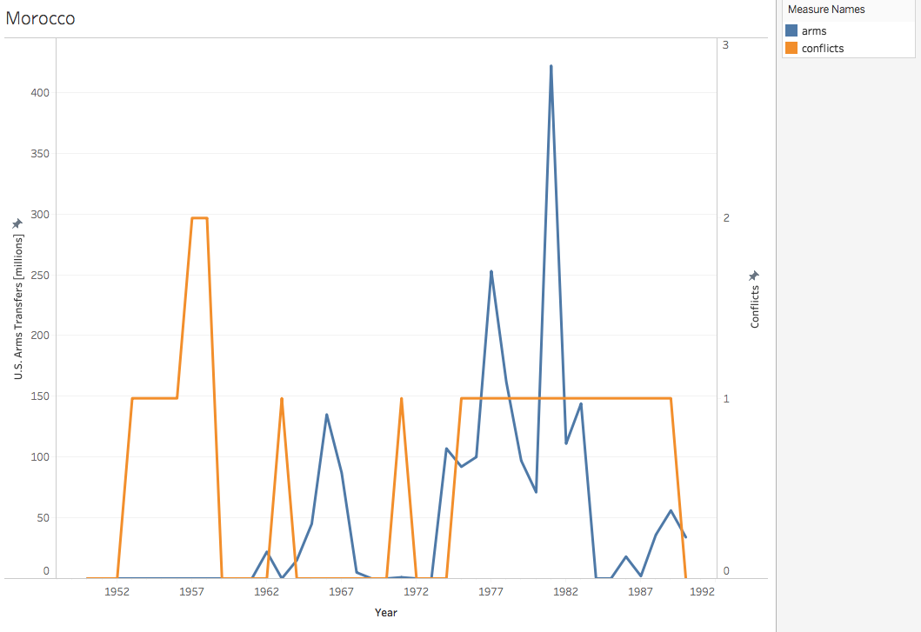
Cold War Conflicts: Analyzing the Role of U.S. Arms Exports
Kara Morrison
AI for the Humanities
Intro
Results
Results
An abundance of datasets on global arms transfers and conflict are available for analysis. While many academics in the humanities use historical or situational context to infer and explain the possible agents for conflict, data science is essential in identifying and defining concrete trends in a dataset. In visualizing data findings, interpretation of statistical correlation is not only made more accessible to those outside the sciences, but allows them to provide narrative explanations for certain inconsistencies or unforeseen trends.
This project focuses on analyzing correlations between U.S. Arms Exports and conflicts in various African Countries during the Cold War through data visualization.
Research Question: What was the relationship between the transfer of U.S. arms and the occurrence of armed conflict in a given country in Africa from 1950-1990?
Hypothesis: There may be a positive correlation between the amount of arms provided by the U.S. and the occurrence of armed conflict in a specific country within this timeframe.
Similar work on this topic has generally found some relationship between arms transfers and the onset of conflict in African countries, but the relationship was often not clear or consistent.
Pearson, Baumann, & Bardos, (1989)
Schrodt (1983)
Craft (1999)
cl
Datasets
Analysis
This project used the Armed Conflict Dataset Version 18.1 from The Uppsala Conflict Data Program/The Peace Research Institute Oslo and the Importer/Exporter TIV Tables on Arms Transfers from Stockholm International Peace Research Institute.
Notes on Dataset definitions for interpretation:
SIPRI
For its arms transfer tables uses the trend-indicator value (TIV). The TIV is based on the known unit production costs of a core set of weapons and is intended to represent the transfer of military resources rather than the financial value of the transfer.
Figures are SIPRI Trend Indicator Values (TIVs) expressed in millions.
Within their dataset a ‘0’ indicates that the value of deliveries is less than 0.5 millions
UCDP
defines conflict as: “a contested incompatibility that concerns government and/or territory where the use of armed force between two parties, of which at least one is the government of a state, results in at least 25 battle-related deaths in a calendar year.”
Defines party: A government of a state or any opposition organization or alliance of organizations. UCDP distinguishes between primary and secondary parties.
This project uses the UCDP’s location variable labelled by a country name(s) described as: the name(s) of the country/countries whose government(s) have a primary claim to the issue in dispute.
In analyzing these visualizations, the results seem similar to that of previous researchers on correlation between arms trade and conflict
While there does appear to be some relationship among these variable within each of the graphs, it is not clear or consistent.
Results found within individual countries were much more likely to have a trend in these variables than when attempting to find patterns between countries.
The hypothesis of a positive correlation between the amount of U.S. Arms Transfers and the occurrence of armed conflict may appear briefly in these countries timelines, only to never appear as correlated again.
This may be a common occurrence among many potential predictors of war.
In future studies, it may be useful to look at other datasets on the same factors to ensure the most accurate results.
Focusing on a more concentrated area, but perhaps more variables may also provide interesting and relevant findings.
Visualizing data similar to this would also be very compelling with possible animated visuals, such as moving timelines.
Methods
References
Data Cleaning Process
Eliminating years outside 1950-1990 study
Limiting the UCDP data variables to the manageable and relevant variables of the SIPRI table
Deciding which method and platform would be best suited to analyze and visualize
Consult with data scientist to assist in changing a dataset from wide data to long data
Ensure the same countries of study are present or not present in each dataset to confirm uniform data
Run datasets through chosen program (Tableau) individually and collective to find the most applicable visualizations
Craft, Cassady. "The Arms Trade and the Incidence of Political Violence in ..." Journal of Peace Research. November 01, 2002. Accessed December 7, 2018. http://journals.sagepub.com/doi/abs/10.1177/0022343302039006003.
Gleditsch et al. (2002), (Eck & Pettersson, 2018) The Uppsala Conflict Data Program/The Peace Research Institute, Oslo Armed Conflict Dataset Version 18.1
IMPORTER/EXPORTER TIV TABLES." Stockholm International Peace Research Institute. 2017. Accessed December 10, 2018. http://armstrade.sipri.org/armstrade/page/values.php.

